Slide 1


REDACADEMY / PROJECT SHOWCASE
Resource
Request Form
A JavaScript-powered ticket management experience
HTML • CSS • JAVASCRIPT
Completed as part of the JavaScript course at
RedAcademy, part of RedPanda Software.
Presented by Brandon De Wet and Ryan Ward
PROJECT PRESENTATION | APPROX. 5 MINUTES

Slide 2
01 / THE IDEA
A clearer way to manage resource requests
A structured form turns support issues into trackable tickets.
CAPTURE
PRIORITISE
TRACK
Requester details, company email, department, resource type and issue description.
Classify issues as Low, Medium, High or Critical so urgency is visible.
Review ticket history and summary, update priorities and record resolutions.
Built around an internal RedPanda Software support scenario.
REDACADEMY | JAVASCRIPT PROJECT

Slide 3
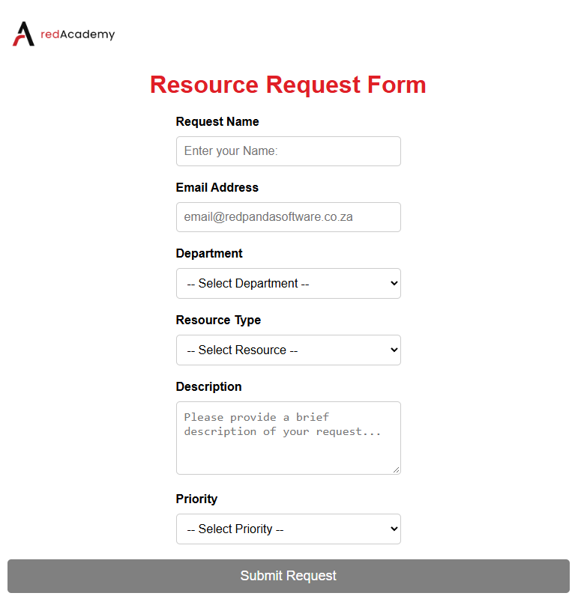
02 / USER EXPERIENCE
Simple inputs. Useful information.
HTML provides the form structure; JavaScript adds validation and updates.
VALIDATION
Required fields and company email format.
LIVE FEEDBACK
The submit button activates when inputs are valid.
TICKET SUMMARY
Latest request, history and open/resolved counts.
REDACADEMY | JAVASCRIPT PROJECT

Slide 4
03 / STRUCTURE AND STYLING
HTML builds it. CSS brings it to life.
A few examples of the structure and styling used in the project.
index.html
style.css
<form id="requestForm">
<div class="form-group">
<label for="requesterName">Request Name</label>
<input
type="text"
id="requesterName"
maxlength="30"
placeholder="Enter your Name:"
required>
</div>
<label for="emailAddress">
Email Address
</label>
<input type="email"
id="emailAddress" required>
<button id="requestSend"
type="submit" disabled>
Submit Request
</button>
</form>
.form-container {
width: 750px;
margin: auto;
padding: 30px;
border-radius: 15px;
background: #fff;
}
button {
background: #ca0707;
color: white;
border-radius: 5px;
}
button:disabled {
background-color: grey;
}
Key concepts: labelled inputs, required fields, reusable styles and responsive layout.
REDACADEMY | JAVASCRIPT PROJECT

Slide 5
04 / JAVASCRIPT LOGIC
The logic behind every ticket
JavaScript validates input, creates objects and refreshes the interface.
script.js
form.addEventListener("submit", function(event) {
// Add the below to prevent the page from refreshing
event.preventDefault();
console.log("New ticket submission started.");
// Object creation for containing all request data
const request = {
id: nextTicketId,
requester: requesterName.value.trim(),
email: emailAddress.value.trim(),
department: department.value,
resource: resourceType.value,
details: details.value.trim(),
priority: priority.value,
status: "Open",
priorityHistory: [],
resolutionReason: ""
};
01 VALIDATE
Check required fields and email.
02 CREATE
Build a ticket object.
03 STORE
Add it to the requests array.
04 REFRESH
Update the list and counts.
REDACADEMY | JAVASCRIPT PROJECT

Slide 6
05 / TICKET MANAGEMENT
More than a form: a basic ticket workflow
The application supports follow-up actions and enforces simple business rules.
CHANGE PRIORITY
RESOLVE TICKETS
STATUS COUNTS
Record the previous and new priority, along with a reason.
Mark tickets resolved and capture a resolution reason.
Use array filtering to count open and resolved tickets.
SECURITY DETAIL
escapeHTML() encodes user-entered characters before they are inserted into HTML, reducing markup injection risk.
REDACADEMY | JAVASCRIPT PROJECT

Slide 7
06 / WHAT I LEARNED
From form fields to a working workflow
This project connected front-end structure with interactive behaviour.
HTML
CSS
JAVASCRIPT
Structure, form fields and labels.
Layout, colour and responsive styling.
Validation, arrays, objects and events.
POSSIBLE NEXT STEPS
• Persist tickets between sessions
• Connect to a backend or API
• Add search and filtering
• Expand accessibility testing
REDACADEMY | JAVASCRIPT PROJECT

Slide 8
07 / WHAT I LEARNED
That is all Folks !!!
Special thanks to:
RedAcademy and RedPanda Software
Wizard a.k.a Nazim Rafudeen
Mahomed Goolam
Emmanuel Madzunye
Nashid Cassiem “Great Hosting 🍴😋”
Demo Time…
REDACADEMY | JAVASCRIPT PROJECT

